Slide 1
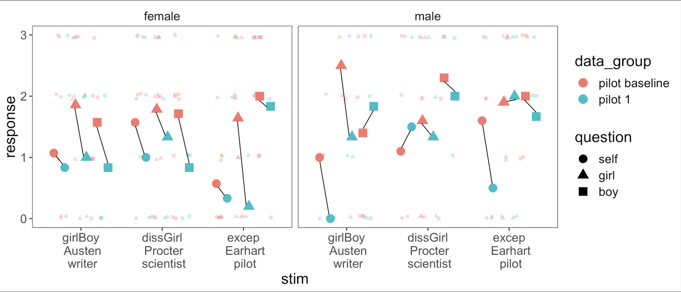
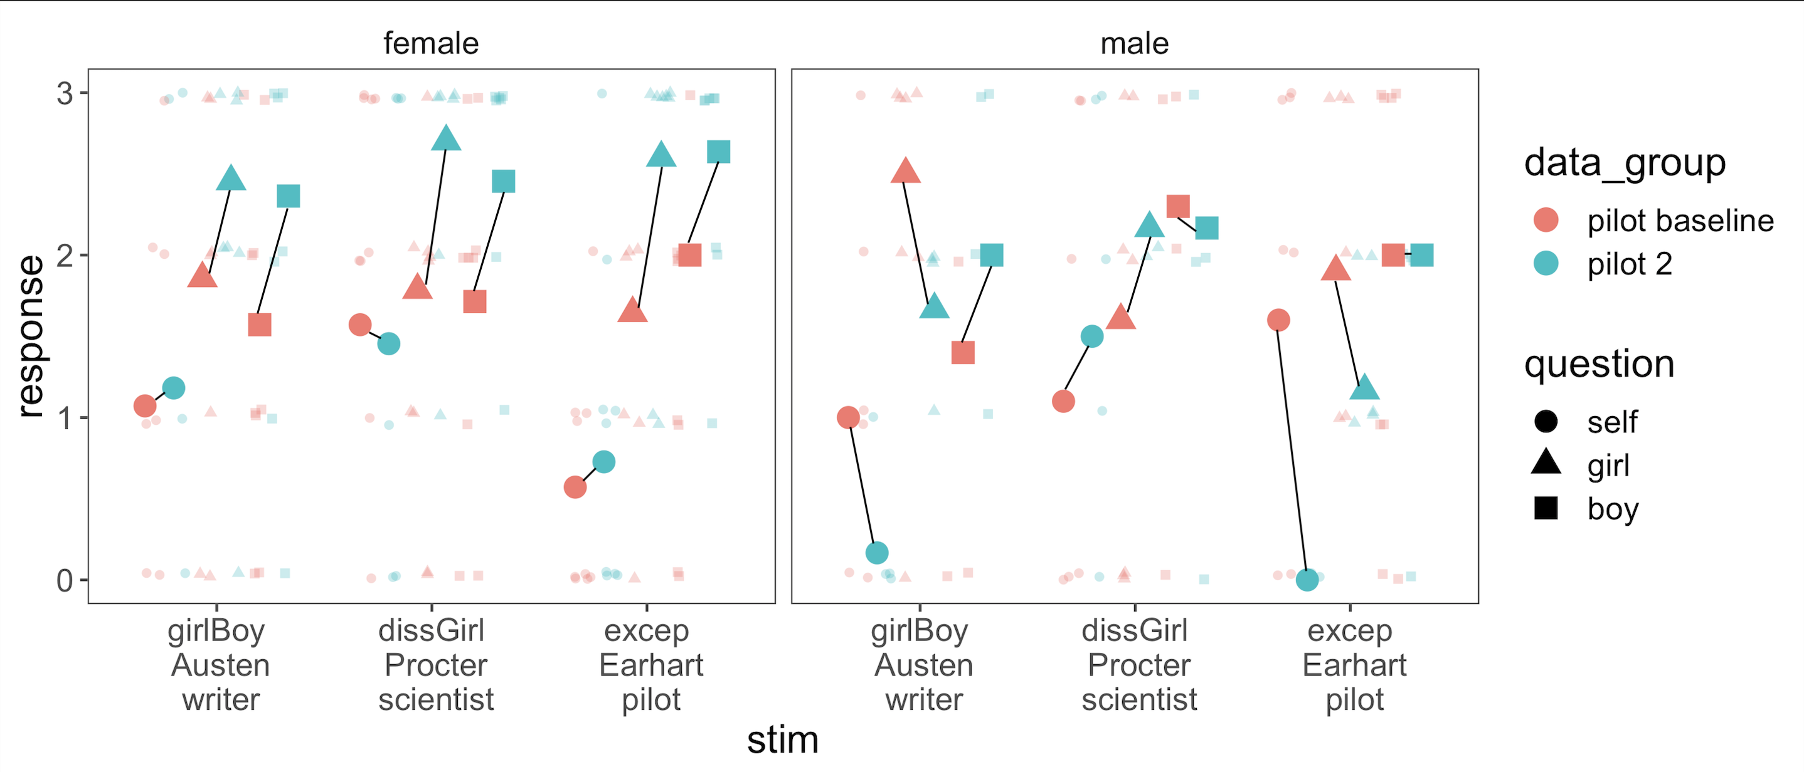
The Storybook Project: Are storybooks designed to motivate young girls actually demotivating?
Aarthi Popat¹, Marianna Zhang¹, Lin Bian², Pooja Mottl¹, & Ellen Markman¹
¹Stanford University, ²Cornell University
Background
Results: Pilot 1
Results: Pilot 2 (ctd.)
Picture books that promote and celebrate female achievement are becoming increasingly popular as a way of motivating girls.
We have noticed that these books often include linguistic and narrative elements that could backfire. These include:
Subject/complement directional statements e.g, “Girls can write just as well as boys”: This common way of expressing equivalence has been documented to actually imply that the item in the complement position is superior (here “boys”).
This is because the complement position represents the norm, or typical entity, which is why we say “Zebras are like horses” rather than “Horses are like zebras” (Tversky, 1977; Gleitman, 1996; Markman & Chestnut, 2016, 2018).
Denigrating “girlish” preferences: e.g. “While other girls liked dolls, Joan liked lizards.” Many girls hearing these books likely enjoy dolls.
Emphasizing exceptionalism—e.g., “[Amelia Earhart flew] faster than any man or woman ever!”—may discourage girls from pursuing a certain field because they believe success in that field requires exceptional innate talent or brilliance (Bian et. al, 2017; Leslie et al., 2015).
Pilot 1 vs. Pilot Baseline
Pilot 2 results were surprising. The books seemed to lower boys’ ratings across the board yet increased girls’ ratings of other children’s interests, which we had not predicted.
Boys’ motivation in Pilot 2 resembled their motivation in Pilot 1
Boys may be averse to stories with female protagonists, which may decrease their motivation (Connor & Serbin, 1978)
However, in Pilot 2, while storybooks elevated girls’ ratings of other children’s motivation, it had negligible effects on their own motivation.
female participants
male participants
Pilot 1 results supported our prediction that although the storybooks are meant to encourage and motivate girls, they might have the opposite effect
Consistently, after hearing the excerpts from these storybooks, girls’ motivation was lower than the baseline data from girls who did not hear anything
Discussion
Our work is still very much in the pilot stage; these are small samples of convenience and our findings in Pilot 2 do not align with Pilot 1, so our conclusions are tentative.
Still, taking both pilot studies together we have reason to believe that, as predicted, these three linguistic/narrative devices are problematic and are failing to inspire girls
In Pilot 1 the excepts appeared to be backfiring, actually lowering girls’ motivation
In Pilot 2, although they didn’t backfire, they showed no signs of improving girls’ own motivation, and left girls being considerably less motivated to pursue these occupations than they thought other boys and girls would be.
Hypothesis: These linguistic and narrative elements could reduce young girls’ motivation to pursue different career fields.
Methods: Pilot 2
Participants: n = 23 5-6 year old children (mean age: 5.82); 12 at Bing Nursery School and 11 at Palo Alto Junior Museum and Zoo (JMZ)
The only change from Pilot 1 was that we added 3-4 repetitions of the relevant sentences to ensure they were noticed: e.g., “Did Jane’s father think that girls could write just as well as the boys? Yes, Jane’s father did think that girls could write just as well as the boys!”
Methods: Pilot 1
Scale
Yes or No
0
Our follow-up study will introduce a new experimental condition to test our predictions more directly
In particular we include a new condition with edited versions of the relevant passages where the content remains the same but the problematic linguistic devices are corrected
This will directly test whether the linguistic and narrative devices are causing this demotivation
We predict a difference in girls’ motivation between conditions, but no difference in boys’ motivation
Girl-to-Boy
(girlBoy)
Denigrating Girlish Things (dissGirl)
Exceptionalism
(excep)
Results: Pilot 2
Subject/complement directional statements:
1
2
3
Pilot 2 vs. Pilot Baseline
Denigrating girlish preferences:
”[Amelia Earhart] flew … faster than any man or woman ever!”
female participants
male participants
“… girls could write just as well as the boys!”
“other girls carried … dolls, [but] Joan carried … lizard!”
Amelia Earhart flew faster than any man or woman ever
Amelia Earhart flew very fast and very high.
Participants: n = 12 5-6 (mean age: 5.27) year old children at Bing Nursery School
Children answered 4 calibration questions to ensure that they understood the scale
Children were read very short excerpts from the three books, each containing one of the three different linguistic or narrative structures
Children were then asked whether they themselves (Self), another girl (Girl), and another boy (Boy) might want to become that profession
Pilot Baseline children (n = 36 5-6 year old children at Cornell, mean age: 4.71) were simply asked the motivation questions with no context, without hearing or seeing any excerpts at all
Acknowledgements
Many thanks to the Markman Lab—Professor Markman, Dr. Powell, Marianna, Cai, and Kristine—for their support and guidance over the summer.

